Slide 1
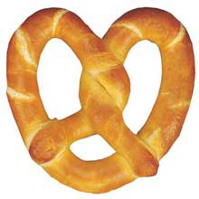
Marcus and Carlos are making homemade pretzels with their father.

Slide 2
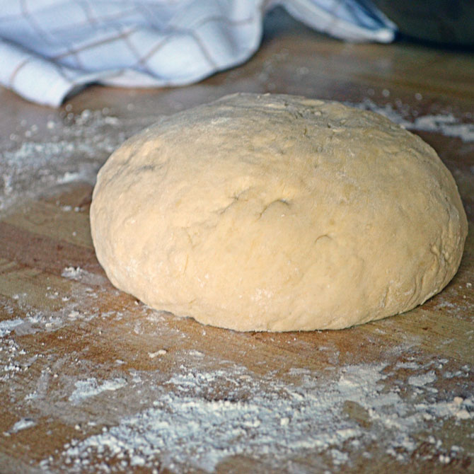
First they make the pretzel dough.

Slide 3
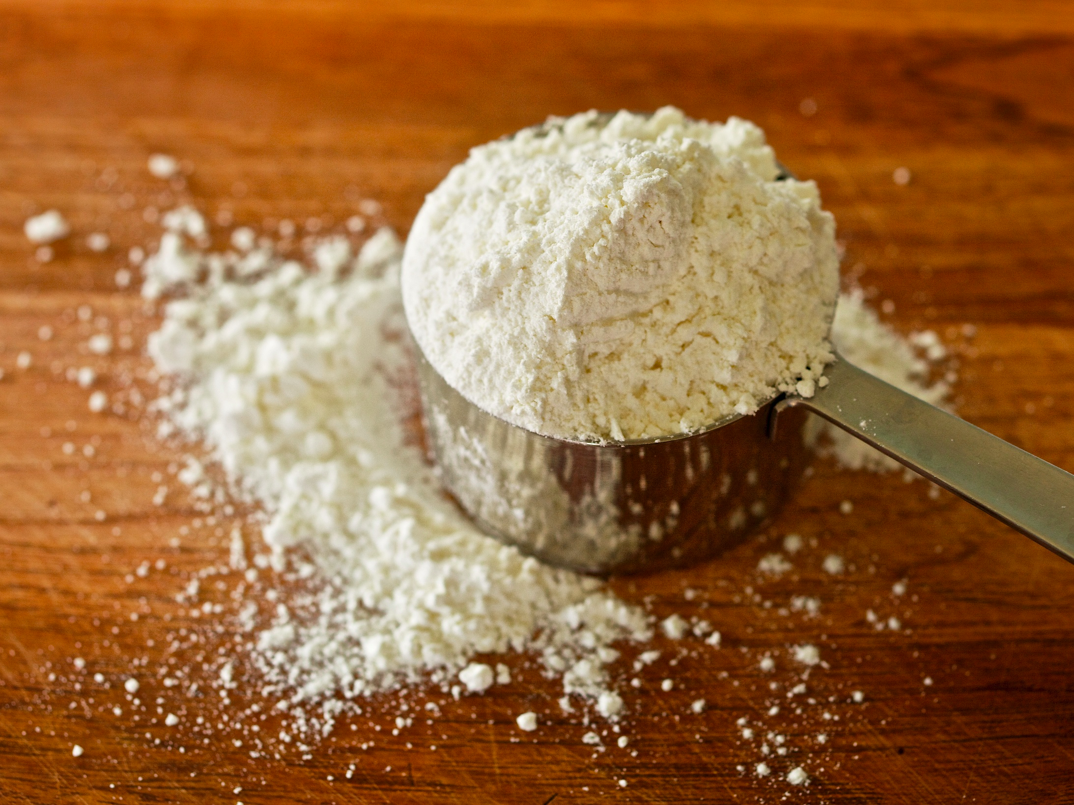
The dough recipe says that they will need a ¼ cup of flour for each pretzel they plan to make.

Slide 4
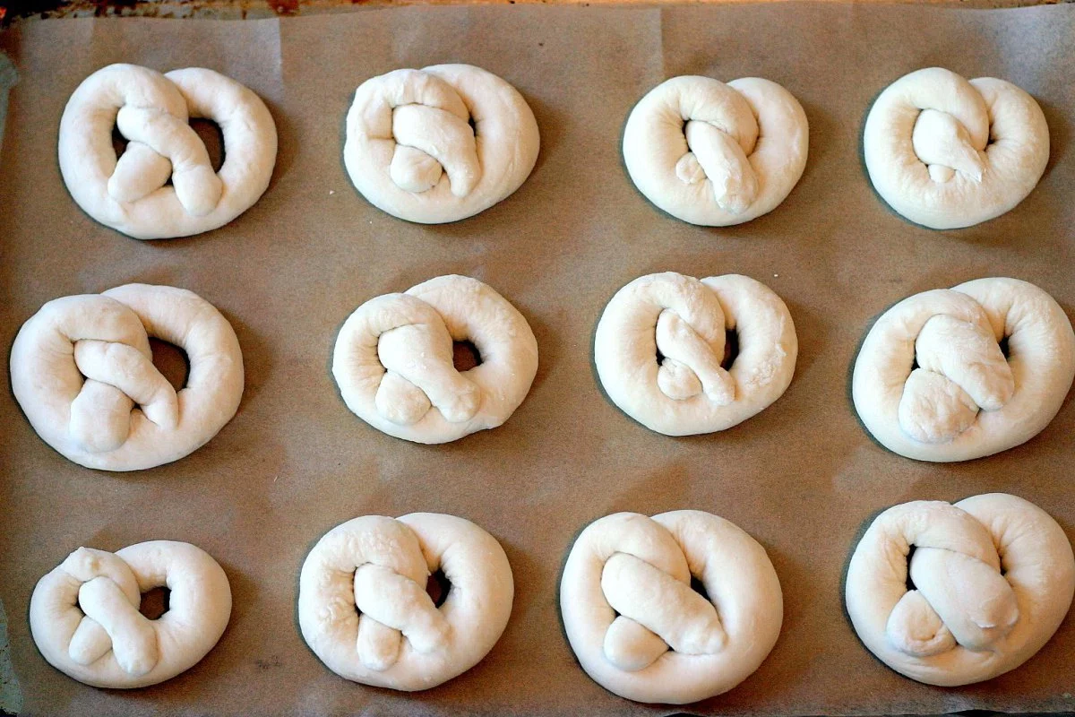
If there are 12 people in Marcus’ and Carlos’ family, how many cups of flour will they need to make the 12 pretzels?

Slide 5
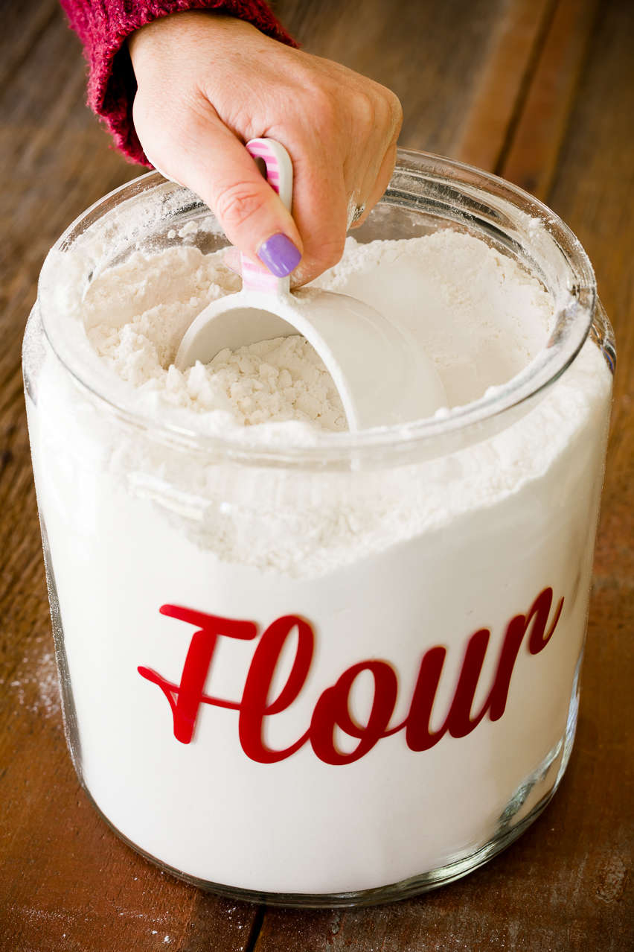
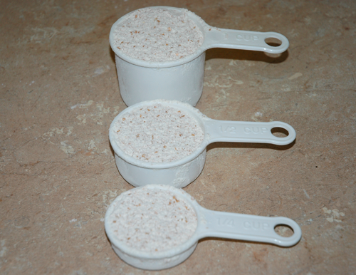
How many pretzels can they make with 8 cups of flour?
What equation represents your answer? Explain.

